Slide 1


Customer Review Analytics

Slide 2



The Team
A proficient and creative data team
Hytham Abdallah
Data Analyst
Maria Karakoulian
BI Engineer
Fabrizio Lucero
Data Scientist

Slide 3






What are we missing?
Better delivery service and improved website attributes are key to address the business problems
The Business Problem
The Major Factors
The Needs
The Solutions
Delivery Delay
The longer the delivery delay, the lower the review score
Faster
Delivery
Product Delivery
Scheduling
10%
Returning
Customer Rate
Shipping Cost
The higher the shipping cost, the lower the review score
Cheaper
Shipment
Free Shipping Threshold
Product Information
The larger the number of pictures, the higher the review score
More Pictures
& Longer Desc.
Product Page Best Practices
76%
Positive
Review Rate
Notes:
https://www.tandfonline.com/doi/abs/10.1080/10696679.1996.11501726
https://www.bigcommerce.com/blog/product-page-examples/

Slide 4




What can we improve?
A personalized marketing strategy can enhance customer experience, hence increase retention rates
The Insights
The Recommendations
80% of orders fall within the 20% of product categories
Discounts & bundled offers on Top product categories
79% of payments are done through credit cards and 18% through mobiles
Personalized vouchers for preferred product categories
Vouchers account for only 2% of payments and 6% of orders
Product recommendations & tailored communications
50% of payments are done in more than 1 installment
Mobile-based payment solutions & installment options

Slide 5
The Approach
We have examined all possible order and product attributes that would impact customer reviews
Order Status
Product
Dimension
Customer Category
Payment Methods
Delivery Duration
Web Display
Order
Features
Product
Features
Review Score
Install-ments
Shipping Cost
Product
Category
Amounts
Price

Slide 6
The Business Insights
Delivery service and website attributes play a vital role in customer reviews
Review Score vs. Delivery Days
Review Score vs. Shipping Cost & Weight
(Days)
Total Duration
Delay
(€)
Weight
Shipment Cost
(Kg)
Review Score vs. Photo Quantity
Review Score vs. Product Description Length
(Words)

Slide 7



The Technical Overview
We examined the data and derived new variables that would have business implications
Variable Creation
Delivery duration days: Duration between purchase date and delivery date.
Delivery delay days: Duration between order delivery date and estimated delivery date.
Product category name: Cumulate sum of all orders by each category. Selects only the top 20% orders that count for 80% of the reviews (Pareto principle) as “in_top_20” or “in_top_20”.
Pipelines for Pre-Processing
Imputer
RFormula
MaxAbsScaler
Replace null values with median
Compute features together and automatically index categorical variables into dummies) –
label: ReviewScore
The function scales each feature by its maximum absolute value

Slide 8
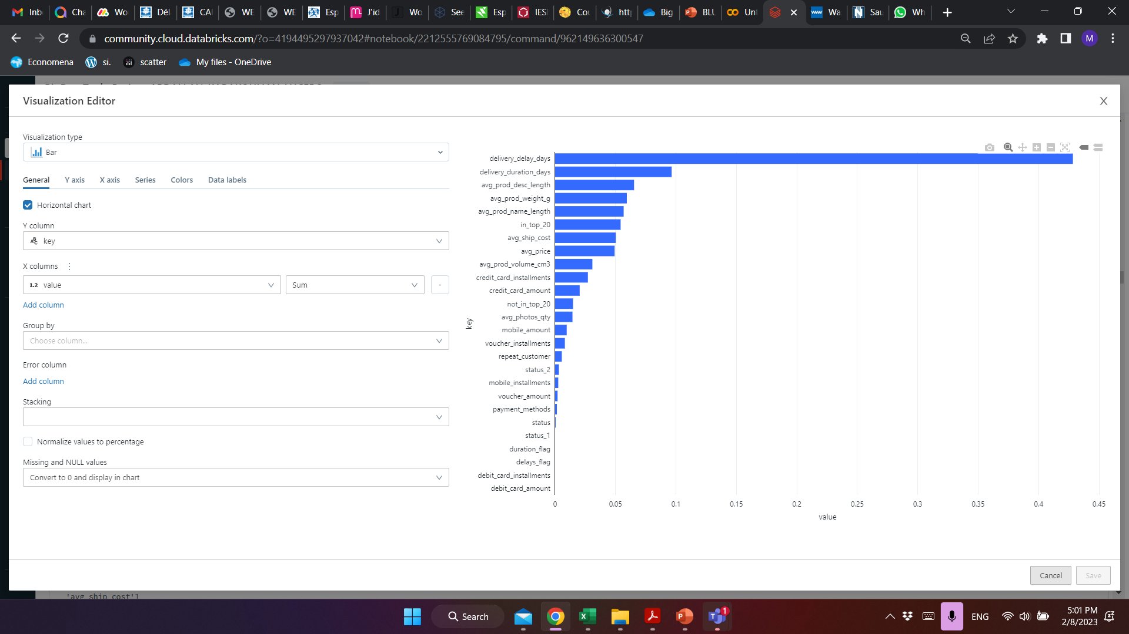
The Technical Overview
We chose the most impactful features, the best performing model with the best combination of parameters
6 Models Tested
Multi-layer Perceptron classifier
Linear Support Vector Machine
Gradient-Boosted Trees
Factorization Machines learning algorithm for classification
Random forest
Logistic Regression
Feature Selection
GBT Classifier
Hyperparameter Tuning
The parameters used were:
MaxDepth of trees ([4,6,8,10,12])
Seed =134
Loss=“logistic”.
Number of folds used were 3

Slide 9
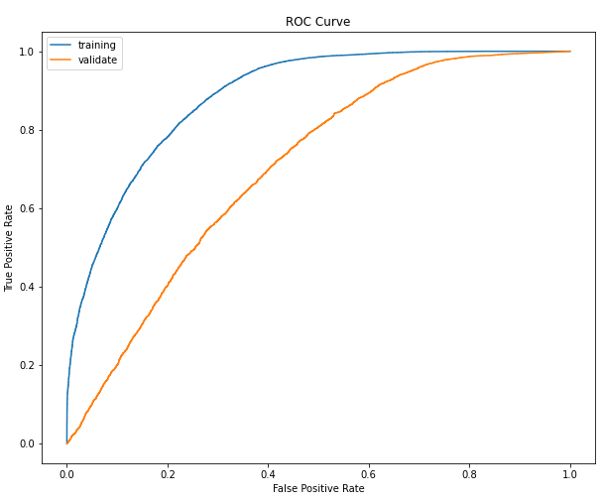
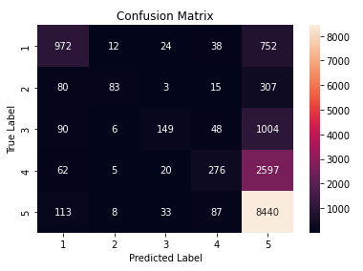
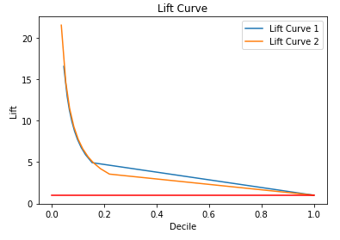
The Technical Overview
We chose the binary classification as it is more accurate and precise
Binary Classification
Multiclass Classification
Area Under ROC Curve 79%
Precision/ Recall trade-off 90%
F1 score 0.57
Accuracy 0.65

Slide 10
The Results
We predict to have 93% positive response rate in the upcoming 4 months
Binary Classification
Multiclass Classification

Slide 11





The Answer
Start a loyalty program and reward system to offer personalized offers and discounts to customers
The Blu Loyalty Reward Program
Forming An Emotional Bond
Personalized with your most preferred product categories
Account Based Loyalty
Accumulate Points to get bigger rewards
Connections Through Channels
Launch a mobile app that sends personalized offers weekly

Slide 12
THANK YOU!

